Slide 1


Dr.N.G.P. Arts and Science College (Autonomous)
Coimbatore 641 048
STEGDETECT
GUIDED BY :
Dr.A.NIRMALA M.C.A., M.Phil. Ph.D
PRESENTED BY :
Mr.V.Balaji
(191CA008)

Slide 2
ABSTRACT
This is the one of the cyber crime happens in the digital world
This is the project to describe about the digital steganography detect
The steganography crime was happen in the Network this Revert to this crime
It is the method of detect Digital steganography on the computing field
This steganography is about LSB method

Slide 3
Steganography is the practice of hiding information inside something normal-looking. Cybercriminals use steganography to hide stolen data or malicious code in images, audio files and other media
Briefly about steganography

Slide 4
How steganography works depends on the type of information that’s hidden and the type of file or site it’s hidden in. Many steganography methods hide information in the way of LSB This revolve about the digital world
CYBER CRIME WORKS

Slide 5
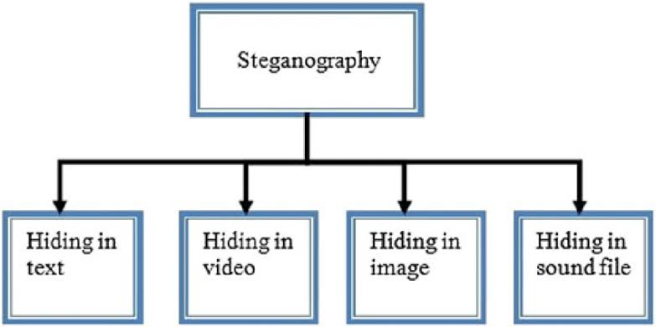


Slide 6
Methodology
This methodology is to detection of the LSB Steganography Method
Using Python Library Programming language for this action
It check the downloading Image or file is malicious scanning function
This has the function to detect and remove

Slide 7
Existing system
Data-Loss Prevention tool and email security
Proposed System
It function in computer systems to check image file has embed text

Slide 8
Thanking You

